Slide 1

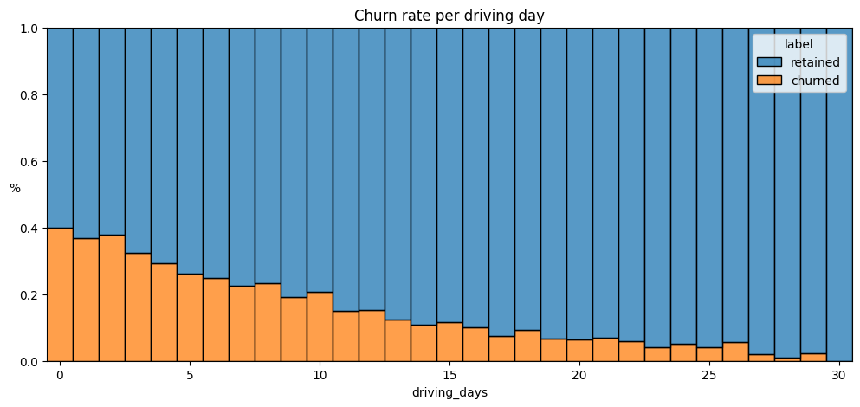
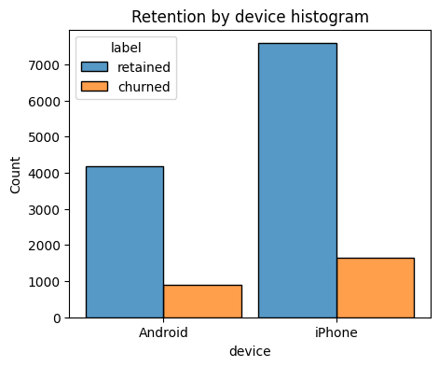
User Churn Project | Exploratory Data Analysis
Project Overview
The Waze data team is developing a data analytics initiative focused on reducing monthly user churn and driving long-term growth for the Waze app. By conducting thorough exploratory data analysis (EDA), the team can identify behavioral patterns that signal churn risk and proactively target users before they disengage. This approach not only strengthens user retention but also enhances overall customer satisfaction.
Key Insights from Exploratory Data Analysis
1. App usage strongly predicts churn likelihood
Users who did not use the app at all in the past month had a churn rate of 40%.
In contrast, users who engaged daily (30 days of use) did not churn at all.
This indicates that higher app usage is a strong protective factor against churn.
2. Driving behavior is linked to churn
Distance per driving day: Users who drove longer distances on each active day were more likely to churn.
Number of driving days: Users who drove more frequently (on more days in the past month) were less likely to churn.
3. User tenure shows no clear pattern
Churn behavior was relatively consistent across users of all tenures, from new sign-ups to those active for ~10 years.
4. Variable distributions reveal engagement concentration
Most engagement-related variables were right-skewed, meaning the majority of users were clustered at the low end of activity (e.g., fewer drives, shorter distances).
Other variables followed a uniform distribution, indicating no clear bias toward low or high activity levels.
5. Data quality issues need attention
Several features contained highly improbable or potentially erroneous outlier values (e.g., driven_km_drives, activity_days, driving_days).
These anomalies should be addressed during data cleaning to ensure model reliability.
The churn rate is highest for people who didn't use Waze much during the last month.
The proportion of churned users to retained users is consistent between device types.
Recommendations
1. Investigate data discrepancies between sessions, driving_days, and activity_days to improve data reliability.
2. Analyze long-distance driver churn with the broader Waze team to uncover behavioral drivers.
3. Run deeper statistical tests to quantify the impact of key variables on churn.
Notes:
REVISED COPY

